Slide 1
HR Putting all together
Pregatit de: Viorel TACLICIU Data: 23.07.2017

Slide 2
Topics - What do we need to remember to complete the HR App? - Complete the application
Pregatit de: Viorel TACLICIU Data: 20.07.2017

Slide 3
What do we need to remember to complete the HR App ?

Slide 4














Remember
Application Server
JSON
Clients
JSON

Slide 5
Remember
FRONTEND
Angular Clients
Use $http service to call backend REST API
BACKEND
REST API to receive and deliver JSON
JSON
JSON

Slide 6
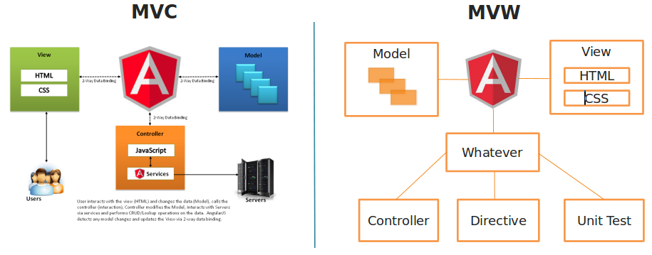
Remember

Slide 7
Remember
Define controllers:
hrApp.controller('EmployeeAddController', ['$scope', '$http', '$location', 'CommonResourcesFactory', 'EmployeeService', 'DepartmentsService', 'JobService', 'ManagerService', function($scope, $http, $location, CommonResourcesFactory, EmployeeService, DepartmentsService, JobService, ManagerService) {
Define services:
hrApp.service('EmployeeService', ['$http', 'CommonResourcesFactory', function ($http, CommonResourcesFactory) { return { findById: function (employeeId) { return $http.get(CommonResourcesFactory.findOneEmployeeUrl + employeeId) .success(function (data) { return data; })
Define routes:
hrApp.config(['$routeProvider', function ($routeProvider) { $routeProvider .when('/employeeAdd', { templateUrl: 'views/employeeAdd.html', controller: 'EmployeeAddController' })

Slide 8
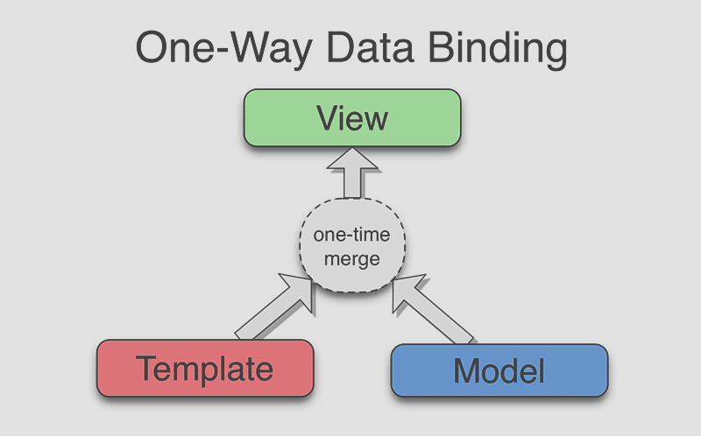
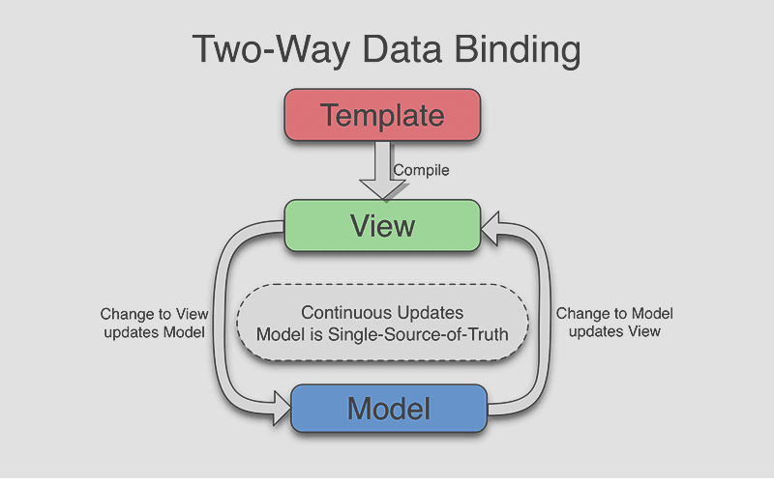
Remember

Slide 9
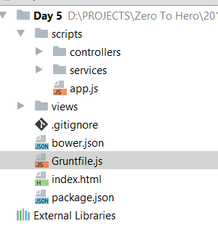
Complete the application
connect: { proxies: [ { context: '/app/mvc/', host: 'your_tomcat_docker_container_ip', port: your_tomcat_docker_port, https: false, changeOrigin: false } ],
Set the grunt proxy to target your backend application

Slide 10
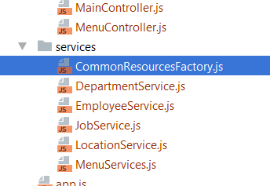
Complete the application
'use strict'; hrApp.factory('CommonResourcesFactory', function() { var baseUrl = "/app/mvc/"; return { findAllDepartmentsUrl: baseUrl + "departments/all", findAllEmployeesUrl: baseUrl + "employees/all", findAllJobsUrl: baseUrl + "jobs/all", findAllLocationsUrl: baseUrl + "locations/all", findOneDepartmentUrl: baseUrl + "departments/one/", findOneEmployeeUrl: baseUrl + "employees/one/", findOneJobUrl: baseUrl + "jobs/one", findOneLocationUrl: baseUrl + "locations/one/", deleteDepartmentUrl: baseUrl + "departments/one/", deleteEmployeeUrl: baseUrl + "employees/one/", deleteJobUrl: baseUrl + "jobs", deleteLocationUrl: baseUrl + "locations", addDepartmentUrl: baseUrl + "departments", addEmployeeUrl: baseUrl + "employees", addJobUrl: baseUrl + "jobs", addLocationUrl: baseUrl + "locations", editDepartmentUrl: baseUrl + "departments", editEmployeeUrl: baseUrl + "employees", editJobUrl: baseUrl + "jobs", editLocationUrl: baseUrl + "locations" }; } );
Ensure that you have the correct url path to your backend application

Slide 11
Z2HDispatcherServlet
Complete the application
Ensure that you have started docker containers
RENAME:
Employee.java
id->employeeId
Department.java
id->departmentId
Job.java
id->jobId
Location.java
id->locationId

Slide 12
Complete the application
Ensure that you also renamed the parameters name from Z2HRequestParam annotations as below
public Employee getOneEmployee(@Z2HRequestParam(name = "employeeId") Long employeeId) {
Do it for all methods from all java controllers
Redeploy application

Slide 13
Complete the application
Transform all $http get(one) /delete from path variable to request parameters
$http.get using path variable
hrApp.service('EmployeeService', ['$http', 'CommonResourcesFactory', function($http, CommonResourcesFactory) { return { findOne: function(employeeId) { return $http.get(CommonResourcesFactory.findOneEmployeeUrl + employeeId) .success(function(data) { return data; })
$http.get using request params
hrApp.service('EmployeeService', ['$http', 'CommonResourcesFactory', function ($http, CommonResourcesFactory) { return { findOne: function (employeeId) { return $http.get( CommonResourcesFactory.findOneEmployeeUrl, {params: {'employeeId': employeeId}} )
Do it for all get(one) /delete methods from all frontend services

Slide 14
Complete the application
Ensure that all pages are working and frontend services bring data from your backend

Slide 15
End of story Z2H 2017

